Slide 2
Gaze Aversions as Non-Verbal Communication
Introduction
“Intentional redirection redirection of gaze away from the face of an interlocutor’

Slide 3
Types of Gaze Aversions
Introduction
Cognitive Processing
Intimacy Modulation
Floor Management

Slide 4
Conversational gaze aversion for human-like robots. In Proceedings of the 10th International Conference on Human-Robot Interaction (HRI). ACM, 2014
Original Paper
S. Andrist, X. Z. Tan, M. Gleicher, and B. Mutlu.

Slide 5
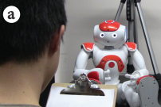
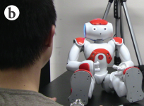
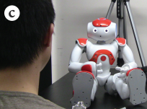
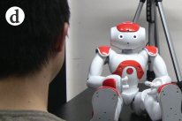
Goal of Study
Original Paper
Time taken for participants to respond before repeating the question

Slide 6
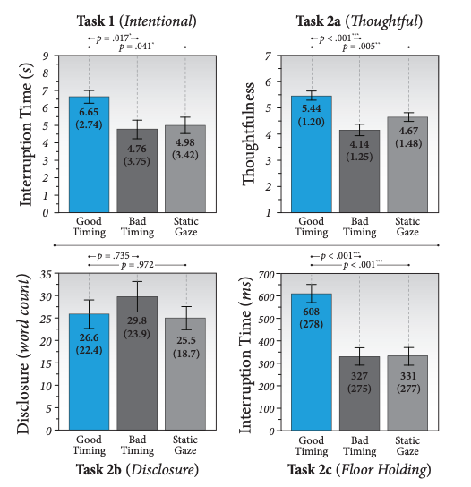
Summary of Findings
Original Paper

Slide 7
Study Limitations
Original Paper

Slide 8
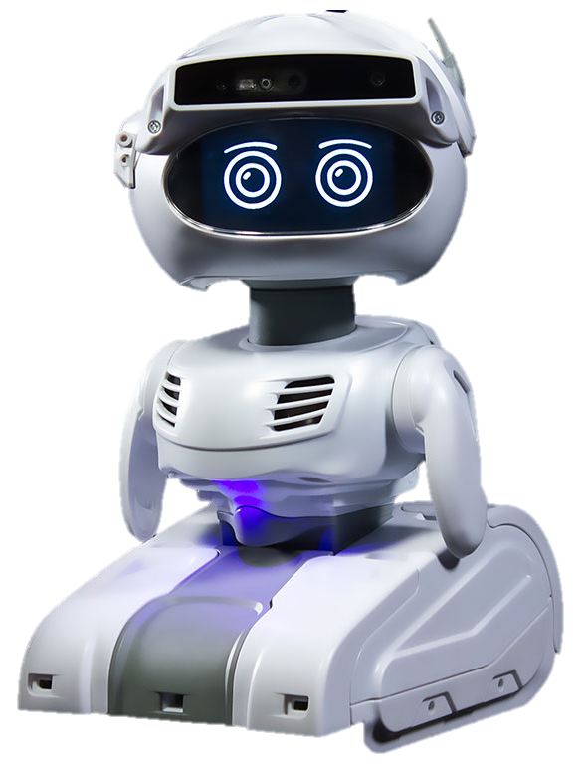
Study Adaptations – Misty II Robot
Study Design
Semi-Virtual Robot capable of rendering eye movement
Native face detection & motion tracking
Female recorded audio samples
Single robot used across all study tasks

Slide 9
Study Adaptations – Independent Variable
Study Design
Independent Variable – Method of Modelling Gaze Aversion
1ST LEVEL
2ND LEVEL
3RD LEVEL
No Gaze Aversions (control condition)
Eyes-Only Gaze Aversions
Head-Only Gaze Aversions

Slide 10
Eyes-Only Gaze Aversions
Study Design
Upwards Aversion
Right Aversion
Left Aversion
Downwards Aversion

Slide 11
Head-Only Gaze Aversions
Study Design

Slide 12
Task 1 – Library Help Desk
Study Design
Cognitive Processing
the library is open from 9am to 5pm
Task Design:
Participants were asked to assume the robot was working at a library help desk and ask 5 library related questions
The robot was programmed to pause 7-10 seconds, conduct a gaze aversion and then respond
Participants were instructed to listen to the robot’s response and ask the question again if they believed the robot did not understand

Slide 13
Task 1 – Library Help Desk
Study Design
Cognitive Processing
Task Goal:
Task Metric:
To evaluate how timing influences perception of cognitive aversions
Time taken for participants to respond before repeating the question

Slide 14
Task 2 – Mock Job Interview
Study Design
Cognitive Processing
I love working with humans!
Task Design:
Participants engaged in a mock interview with the robot
The robot took the role of the interviewee and the participant took the role of the interviewer
Participants asked the robot 5 interview questions derived from actual job interviews

Slide 15
Task 2 – Mock Job Interview
Study Design
Cognitive Processing
Task Goal:
Task Metric:
To determine how different modalities of aversion influence perception of the robot’s creativity and thoughtfulness
Survey subjectively measuring perception of robot’s thoughtfulness

Slide 16
Task 3 – Therapist Aide
Study Design
Intimacy Modulation
How has your day been?
Task Design:
The robot assumed the position of a therapist’s aide
Participants were required to provide responses to a series of 5 questions with increasing levels of intimacy

Slide 17
Task 3 – Therapist Aide
Study Design
Intimacy Modulation
Task Goal:
Task Metric:
To determine how different modalities of aversion influence comfort and intimacy levels between a robot & participant
Number of words participants used to answer each question

Slide 18
Task 4 – Getting to Know Each Other
Study Design
I’m from Boulder, Colorado!
Floor Management
Task Design:
Participants asked the robot 5 questions, after which they were directed to listen to the robot’s response before providing their own
The robot’s response was split into two sections, separated by a 2-4 second pause.
The robot did not provide the second section of its response if interrupted

Slide 19
Task 4 – Getting to Know Each Other
Study Design
Floor Management
Task Goal:
Task Metric:
To determine how different modalities of aversion influence perception of a robot’s ability to hold the floor during conversation
Time between sections of robot’s response before participants interrupted or robot continued speech

Slide 20
Study Procedure
Study Design
Between Subjects Experimental Design
15 Participants

Slide 21
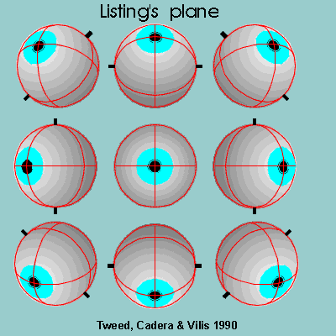






Developing the Eyes-Only Model
Study Design
Axes of Extraocular Movements
Gaze Aversion Stills
Gaze Aversion Animation

Slide 22
Developing the Head-Only Model
Study Design

Slide 23
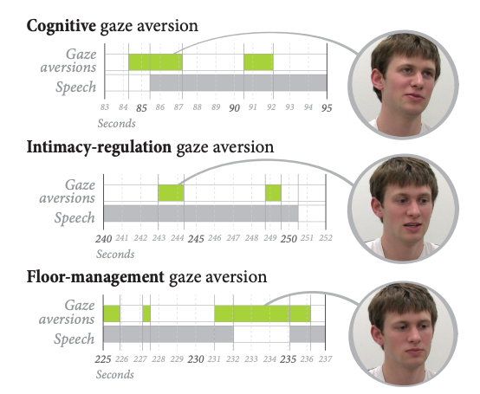
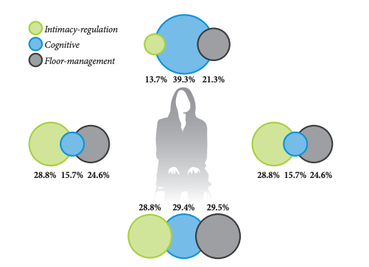
Modelling Different Aversion Types
Study Design
Gaze aversion timings for different conversational functions
Percentage of gaze aversions directed up, down, left or right based on conversational function

Slide 24
Conducting the Study
Study Design
Insert videos here

